Slide 1
-: Assignment 6 :-
JSON into CSV files using Python
Made By: Pratik and Jigar

Slide 2
* What is JSON and CSV?
JSON
JSON is nothing but JavaScript Object Notation which is a file used to store data in the form of key-value pair.
It is a format in which we can transfer data from server to client and vice-versa.
Python supports it through a built-in module/package called JSON.
CSV
A comma-separated values file is a delimited text file that uses a comma to separate values.
Each line of the file is a data record.
Each record consists of one or more fields, separated by commas.
The use of the comma as a field separator is the source of the name for this file format

Slide 3
* How to Convert a JSON to CSV using Python
Step 1- Prepare a JSON String
Step 2: Create the JSON File
Step 3: Install the Pandas Package Or Alternative part is
Take a JSON file, put in a path after that take on variable to save
it in the csv format.
Step 4: Convert the JSON String to CSV using Python
# Apart from this there are online compilers to do so. But this are some frequently used methods.

Slide 4
* Example On converting JSON into CSV
Let's say we have a json file as follows:
{
"details":[
{
"name": "Richard",
"class": "4",
"marks": "72"
},
{
"name": "David",
"class": "4",
"marks": "78"
},
{
"name": "Emily",
"class": "4",
"marks": "89"
}
]
}
#code for conversion:-
import json
import csv
with open("D:\github repo\python\sample.json") as file:
data = json.load(file)
fname = 'output2.csv'
with open(fname, 'w') as file:
csv_file = csv.writer(file)
csv_file.writerow(["name", "class", "marks"])
for i in data["details"]:
csv_file.writerow([i["name"], i["class"], i["marks"]])
A file named "output2" with type "csv" will be created.

Slide 5
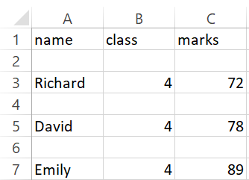
# Output for the code

Slide 6
Thank You
Regards- KPI Partners.

